Slide 1
SEC555
Presentation based on SEC555: SIEM with Tactical Analytics
GIAC Certification for SIEM
Justin Henderson (GSE # 108) @SecurityMapper

Slide 2

About Us
Author of SEC555: SIEM with Tactical Analytics
GIAC GSE # 108, Cyber Guardian Blue and Red
58 industry certifications (need to get a new hobby)
Two time NetWars Core tournament winner (offense)
And security hobbyist and community supporter
Collecting interns/contributors in bulk (research teams)
Release research to the community
See https://github.com/SMAPPER

Slide 3
Welcome!
A copy of this talk is available at: https://github.com/HASecuritySolutions/presentations
More free stuff: https://github.com/HASecuritySolutions

Slide 4
Certification Experience
Cisco
CompTIA
EC-Council
EXIN (ITIL)
GIAC
ISACA
ISC2
Microsoft
Oracle
PMI
Sonicwall
Tenable
VMWare
And a few others…

Slide 5


Meaning of Certification
What does it mean to have a certification?
You haven proven a minimum set of skills or knowledge
Means one of two things based on the certification

Slide 6
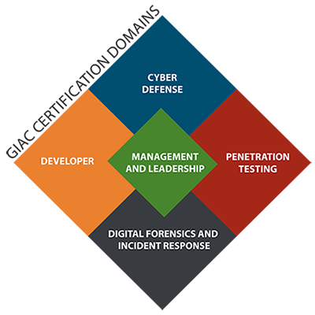
Why GIAC?
GIAC creates professional certifications
Certifications are job-specific
Based on hands-on knowledge
Requires experience
Not just knowledge and theory
Obtaining a GIAC certification gives definition
Explains what one is capable of

Slide 7
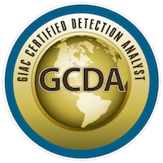
GIAC Certified Detection Analyst (GCDA)
The GCDA is a new GIAC certification
Emphasis is on logging and analysis with a SIEM
Heavily geared towards tactical detection
"The GIAC Certified Detection Analyst (GCDA) is an industry certification that proves an individual knows how to collect, analyze, and tactically use modern network and endpoint data sources to detect malicious or unauthorized activity. This certification shows individuals not only know how to wield tools such as Security Information and Event Management (SIEM) but that they know how to use tools to turn attacker strengths into attacker weaknesses." ~ Justin Henderson, SANS SEC555 Course Author

Slide 8
What the GCDA proves?
The GCDA certification proves candidates can:
Understand SIEM components and recommend changes
Implement a strategic data collection strategy
Apply and understand log enrichment
Identify and use key network data
Identify and use key endpoint data
Develop processes for handling alert data
Use data to catch modern attacks

Slide 9

SIEM Architecture
Analysts often have limited training on SIEM architecture
Some analysts would even say it is unnecessary to know
Truth is, knowledge of how a SIEM works affects analysis
Method of data collection can change data (good or bad)
Metadata in logs helps analysis
SIEM != Log collection
Log metadata and enrichment adds value

Slide 10

Data Collection Strategies
Strategic data collection is an art
Vendors, compliance, and tactical guides often lean towards a collect everything model
Often the cause of a SIEM failure
Tactical data collection can still meet compliance and business requirements
While providing longer data retention
And making analysis easier
Focus also is on optimizing log formats

Slide 11
Log Enrichment
A GCDA candidate should not use a SIEM as a log collector
A SIEM should enhance a logs value to analysis
Consider a DNS log containing sec555.com
Malicious, suspicious, or benign?
Domain is helpful but lacks context
Enrichment can add context for analysis such as:
Domain is not a top 1 million domain (tags:not_top_1m)
Domain does not appear to be random (frequency_score:15)
Domain registration (reg_date:2016-09-08T03:21:24Z)

Slide 12
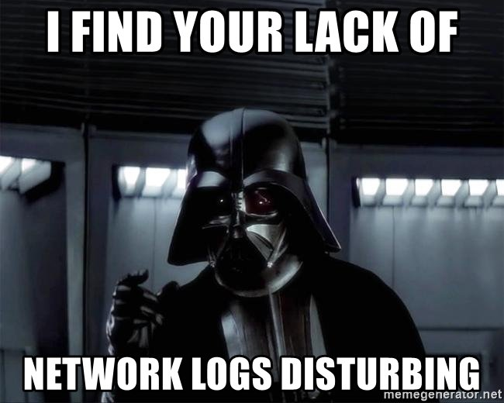
Network Data
A SIEM is only as good as the data it has
The problem is there are too many data sources to choose from
Network data is easy to obtain and highly valuable
DNS
HTTP
HTTPS
Netflow
Collection does not have to impact production systems

Slide 13
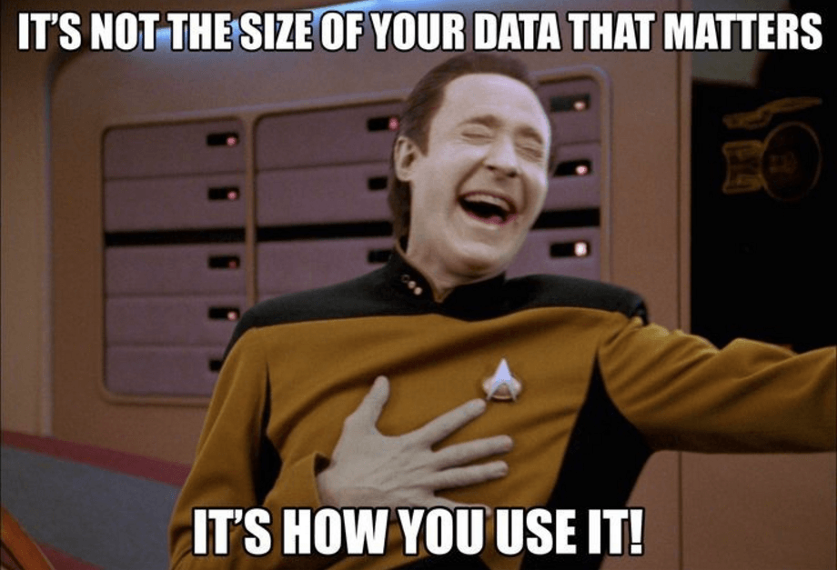
Endpoint Data
Endpoints generate massive amounts of logs
If you think you are collecting ALL the built-in logs, then you are probably wrong
Some logs need enabled
Agents do not pickup all logs
May not even be able to
A GCDA will know and understand the variance of Windows vs. Linux
And they'll know which logs matter

Slide 14

Alert Data
Alerts from a SIEM or down-level security system are:
High in volume
Full of false positives
A GCDA should be able to:
Use enrichment and other techniques for false positive reduction
Implement meaningful alerts
Build reports for alert tuning

Slide 15
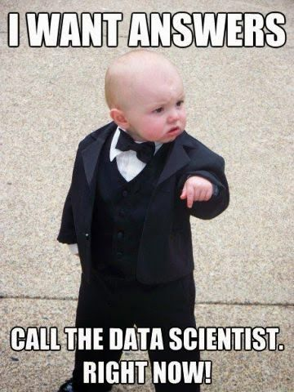
Tactical Data
Lots of emphasis is placed on technology
GCDA puts it back on people
A GCDA can layer multiple high-fidelity detects using simple data
Less false positives
More meaningful alerts
Unlikely adversary gets past all detects
Turns attacker strengths to weaknesses

Slide 16
Summary
If you are looking for a certification that matters…
Check out the GIAC Certified Detection Analysts
Also, check out SEC555: SIEM and Tactical Analytics

Slide 17

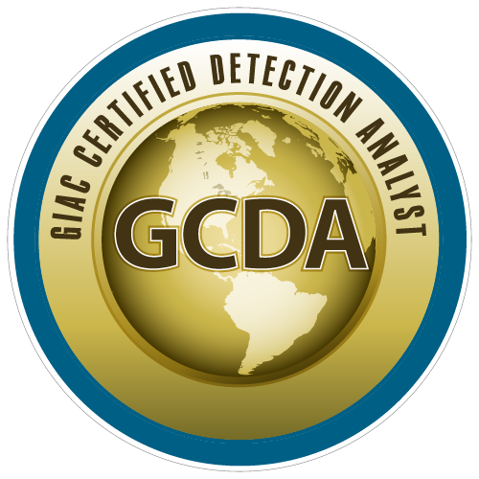
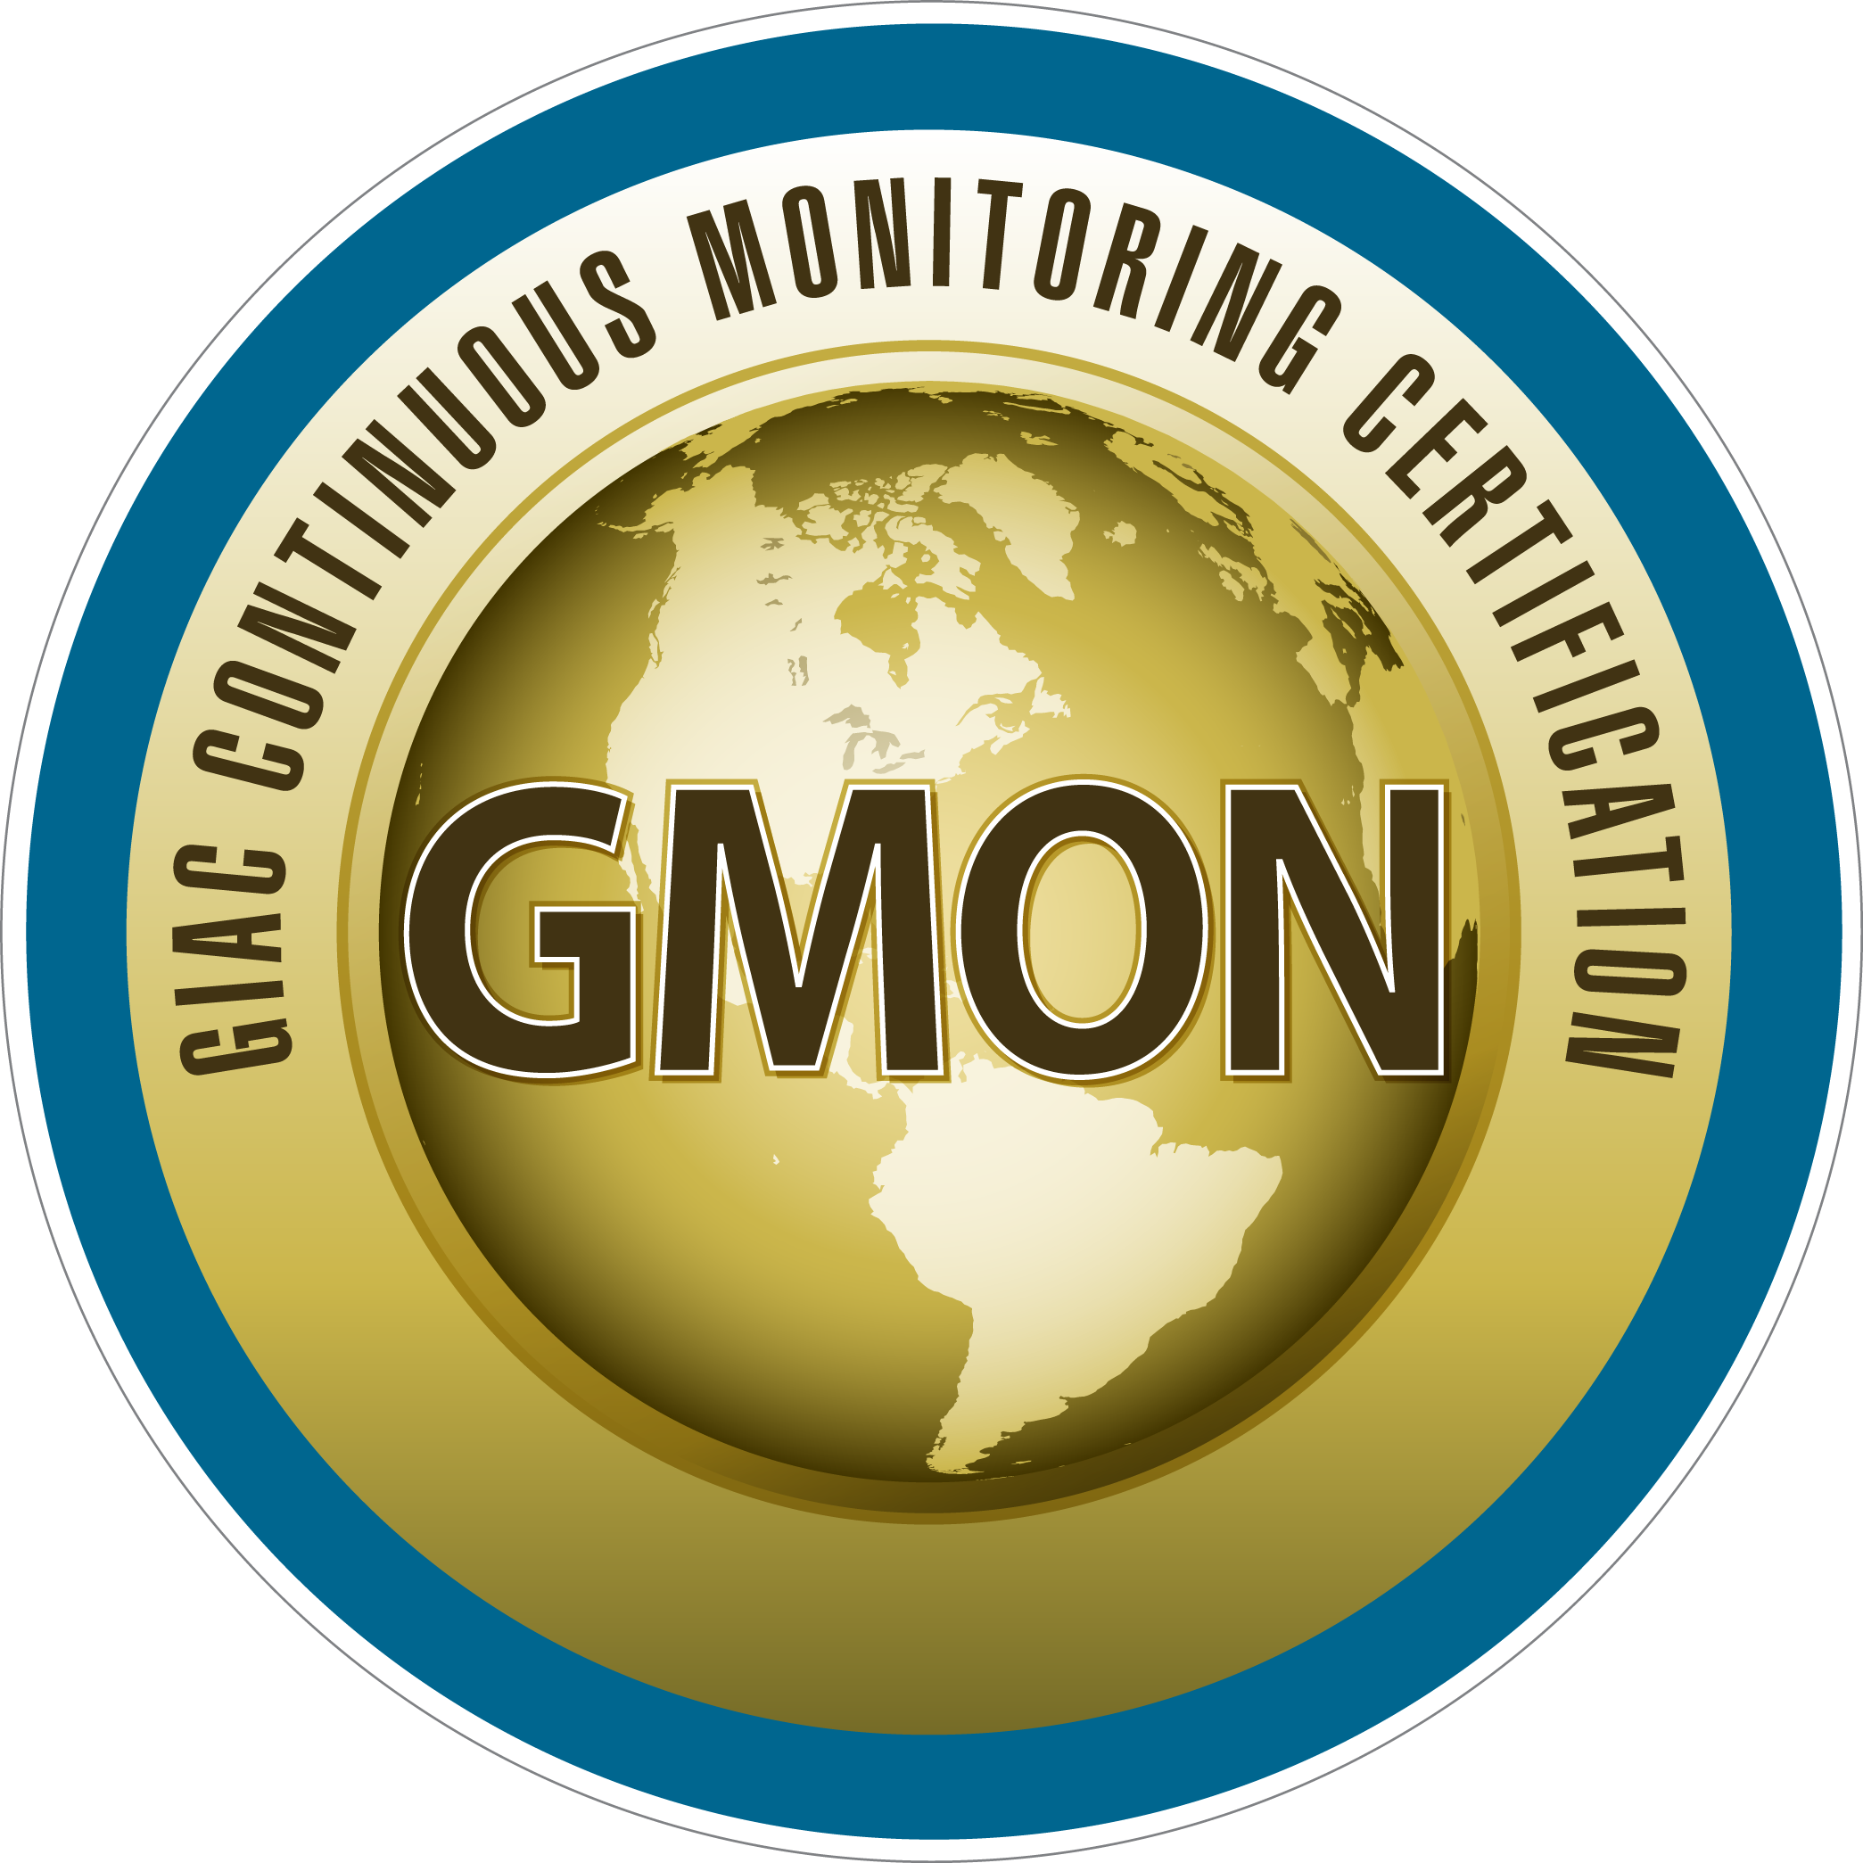
Blue Team Summit & Training
Save the Date: April 23 - 30 Louisville, Kentucky
sans.org/BlueTeam
SEC530 – Defensible Security Architecture
SEC555 – SIEM with Tactical Analytics
SEC511 – Continuous Monitoring & Security Operations
MGT517 - Managing Security Operations
Cyber Defense NetWars
SUMMIT
April 23-24
TRAINING
April 25-30
sans.org/BlueTeam
Notes:
Drag Picture and Send to Back

